Slide 1

Chapter 8 Business Communication PDF Book By Vikram Bisen

Slide 2
Content
Define case Study
Types of Case Study
Case study Competition
Preparing a case study: Reading strategy of case study and Solution strategy
Do’s and Don’ts for case preparation
Mock Consulting Interview - Consultant - YouTube
https://www.youtube.com/watch?v=psuKyBsH1oo
case interview with former mckinsey interviewer ... - YouTube
https://www.youtube.com/watch?v=fuys5fWCxJM
McKinsey & Company is an American worldwide management consulting firm, founded in 1926 by University of Chicago professor James O. McKinsey,
McKinsey & Company provides strategy and management consulting services, such as providing advice on an acquisition, developing a plan to restructure a sales force, creating a new business strategy or providing advice on strategic management to corporations, governments, and other organizations

Slide 3
What is Case Study
A case study is a description of an actual administrative situation involving a decision to be made or a problem to be solved. It can be a real situation that actually happened just as described, or portions have been disguised for reasons of privacy.
Most case studies are written in such a way that the reader takes the place of manager whose responsibility is to make decisions to help solve the problem.

Slide 4


Case study Competition
Consultants/ Advisor BoD/ Boss
Participants
Judges

Slide 5

Types of Case Study
Problem
Decision
Evaluation

Slide 6
Preparation of a case study
Reading strategy of case study
Speed Reading
Appendices
Case type
Thorough reading

Slide 7
Speed Reading
Goal: What the case is about?
Read first and last paragraph. First and last sentence.
Read Introduction and Conclusion
Find out key options and decision options
Structure of the case

Slide 8
For Instance Business Case Study
Whether you’re a B2B or B2C company, case studies can be a powerful resource to help with your sales, marketing, and even internal departmental awareness and it encompasses strategic insights alongside anecdotal and qualitative findings
Conduct a B2B case study by researching the company
Identify the short-term and long term goals and solutions
Use Model
Use charts to visualize data in your business case studies

Slide 9
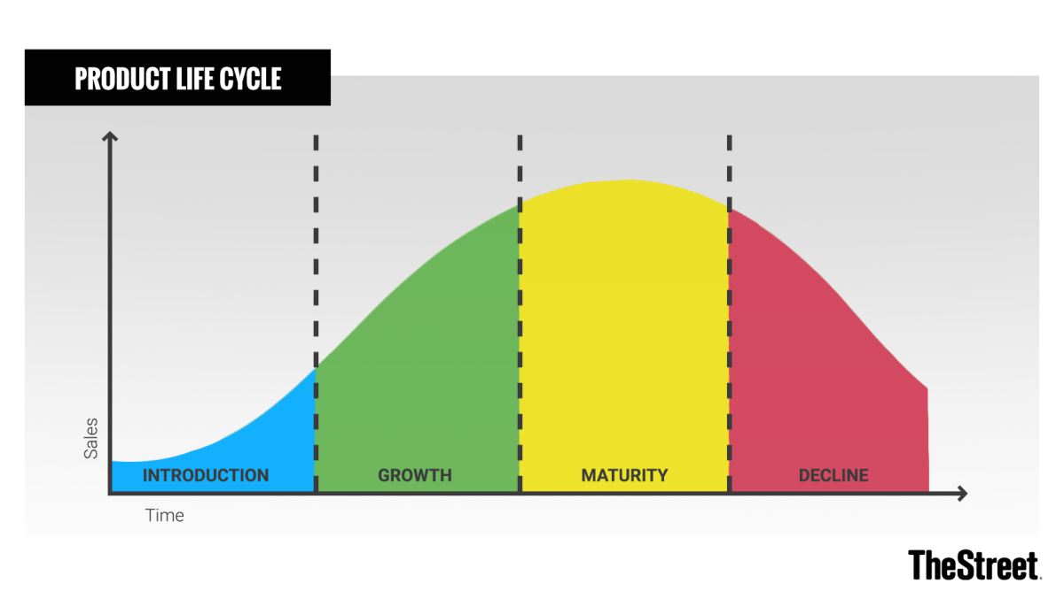

Slide 10
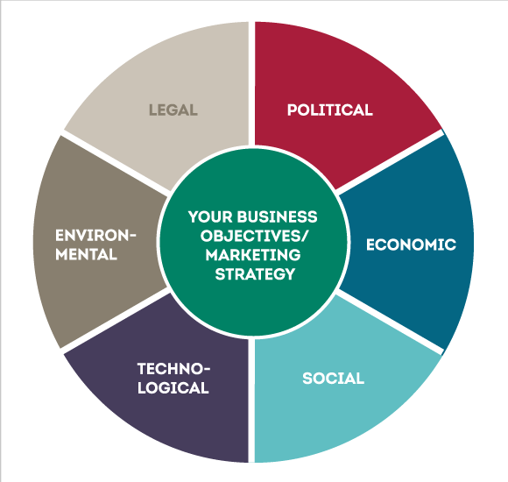
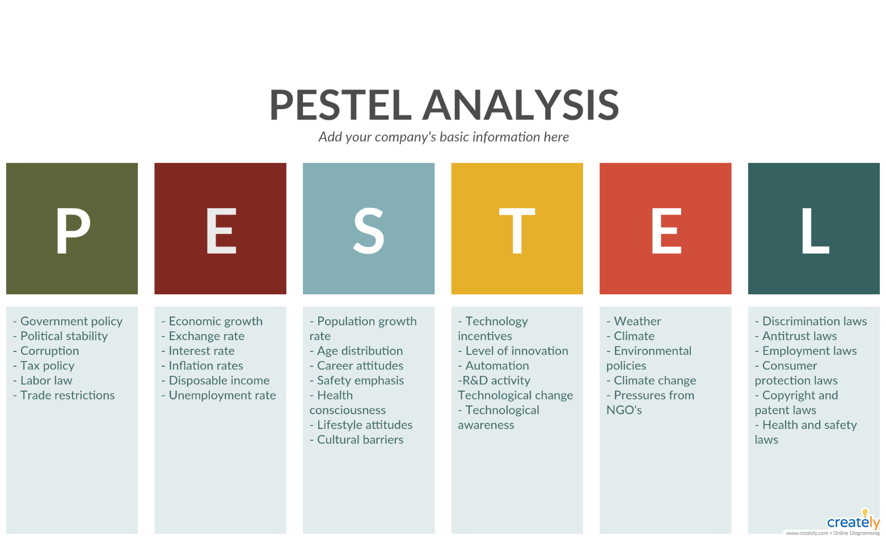
Solving case with different models

Slide 11
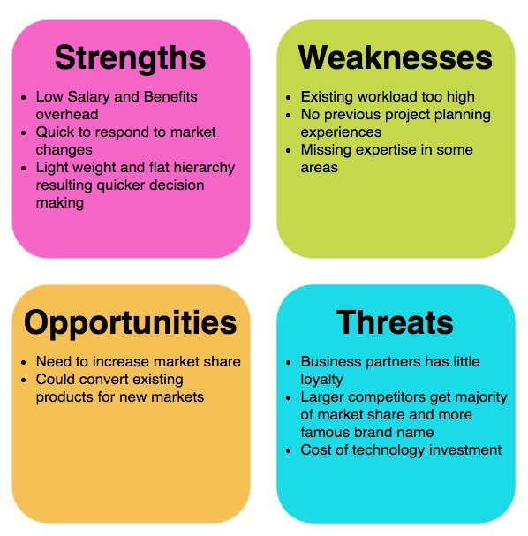
SWOT analysis

Slide 12
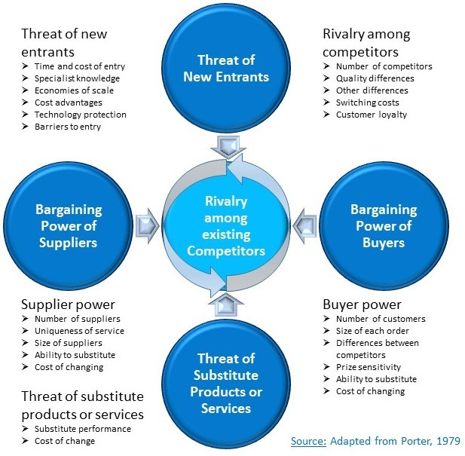
Porter’s Five Force Model

Slide 13
Solution Strategy
Situation Analysis
Issue Identification
Decision Alternative
Recommendation

Slide 14
Situation Analysis
Company
Industry
Competitor
Macro factor

Slide 15

Company
 | Background Key stakeholder Recent Performance: Financial Analysis Decision Type Model: SOWT, Stakeholder Analysis

Slide 16
Financial Analysis
 | Profitability: ROI, ROA Liquidity: Current ration, Quick ratio Risk position: Debt to equity ratio Forecasting: Prediction

Slide 17

Industry
 | Lifecycle Stage Key success factor Recent Changes Insight Model: Pestle, Porters five forces Source: Industry, Country Section

Slide 18

Competitors
 | Key competitors Differentiation Point Strategic Plan Recent Performance
Cost Leadership strategy
Differentiation Strategy
Niche marketing strategy

Slide 19
Competitor Analysis Tea market in BD with established market player
 | Target market | Market position | Positioning statement | Feelings
Isphahani Mirzapore | Mass( Middle, Top) | Top |  | Fulfillment
Kazi and Kazi | Niche (Upper health conscious) | Top among healthy category | 100% organic | Healthy

Slide 20
Issue Identification
Problem (what might be the reasons of sales/profit reduction, project failure)
Proposal ( as a top level manager, you can make a proposal for better solution/decision) e.g. COVID situation online class conduct.
Ethical

Slide 21
Prioritization of Issues
Nature ( nature of an incident, SWOT, solve it)
Impact ( to maintain a sustainable market position you need R&D, advertising, investing decision etc.)
Urgency ( long run and short run project urgency)
Priority (top issue)

Slide 22
Decision Alternatives
From a number of alternative criteria/ solutions, choose the best one.
Recommendation
Recommend the decision to your boss/company

Slide 23
DO’S AND DON’TS FOR CASE PREPARATION
DO’S: | DON’TS:
1. Know the case backwards and forwards before you begin your case study analysis. 2. Give yourself enough time to write the case study analysis. You don't want to rush through it. 3. Be honest in your evaluations. Don't let personal issues and opinions cloud your judgment. 4. Be analytical, not descriptive. 5. Proof-read your work. | 1. Don’t quit at the most obvious answer-try playing devil's advocate; put yourself in the other person's shoes. 2. Don’t try to solve all the problems you identify. It is better to try to address a very few well rather than attempting to do so much. 3. Try to avoid confusing symptoms with problems making premature evaluations. 4. Write in a formal manner suitable for scholarly work, rather than a letter to a friend

Slide 24


